Slide 1


PaNOSC use cases EGI Conference 2019
7th May, 2019
Author: Jamie Hall, Jean-Francois Perrin, Philippe Le Brouster (ILL)
This project has received funding from the European Union’s Horizon 2020 research and innovation programme under grant agreement No. 823852

Slide 2
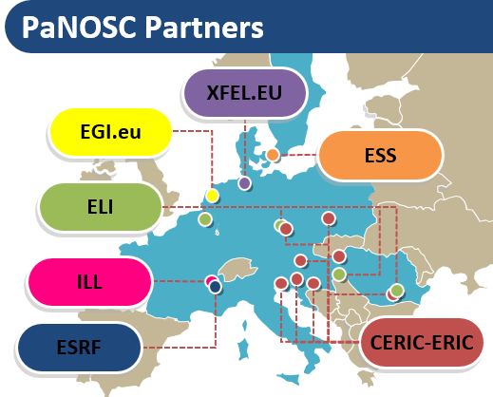
PaNOSC
The Photon and Neutron Open Science Cloud (PaNOSC) is a cluster of ESFRI Research Institutes which proposes to align the efforts of the existing and new photon and neutron sources to make FAIR data a reality and link up to the European Open Science Cloud.
https://github.com/panosc-eu/panosc/wiki

Slide 3
The community
50,000 users – Biology, Medicine, Materials, Chemistry, Nuclear Physics, Particle Physics, Cultural heritage, Geology … and industrial applications.
State of the art Large Scale Facilities – 5 ESFRIs + 25 national RIs (PaNs)
Data policies implementing FAIR principles – PaNdata data policy
10s of Petabytes of scientific data, curated and archived for 5-10+ years
PaNs manage and provide access to data from experiments across Europe
Working together PaNOSC + ExPANDS

Slide 4
KPIs – Before PaNOSC - 2018
 | ILL | ESRF | CERIC | XFEL | ELI | ESS
Data / yr | 200 TB | 8 PB | 1 PB | 3PB | < 1 PB | 0
Data Policy | 2011 | 2016 | 2014 (3/8) | 2017 | In progress | 2017
Metadata catalogue | Local | Icat | Local | myMdC | No | SciCat
Metadata definitions | Nexus | Nexus | custom | myMdC | ? | Nexus
DOI | 2012 | 2018 | No | 2018 | No | 2018
Open Data | Yes | Yes | No | Yes | No | No
Data analyses Services | Pilot | In progress | Remote | In progress | ? | In progress
Common data API | No | No | No | No | No | No
User training | No | No | No | No | No | No

Slide 5
KPIs after PaNOSC – 2023
 | ILL | ESRF | CERIC | XFEL | ELI | ESS
Data / yr | 600 TB | 50 PB | 15 PB | 100PB | 10 PB | <1PB
Data Policy | 2011 | 2016 | 2019 | 2017 | 2019 | 2017
Metadata catalogue | Local | Icat | Icat | myMdC | [TBD] | SciCat
Metadata | Nexus | Nexus | Nexus | Nexus | [Nexus] | Nexus
Metadata collection | All BLs | All BLs | All BLs | All BLs | All BLs | All BLs
DOI | Yes | Yes | Yes | Yes | Yes | Yes
Open Data | Yes | Yes | Yes | Yes | Yes | Yes
Common API | Yes | Yes | Yes | Yes | Yes | Yes
User training | Yes | Yes | Yes | Yes | Yes | Yes
Data Services | Prod | Prod | Prod | Prod | Prod | Prod
EOSC | Integrated | Integrated | Integrated | Integrated | Integrated | Integrated

Slide 6
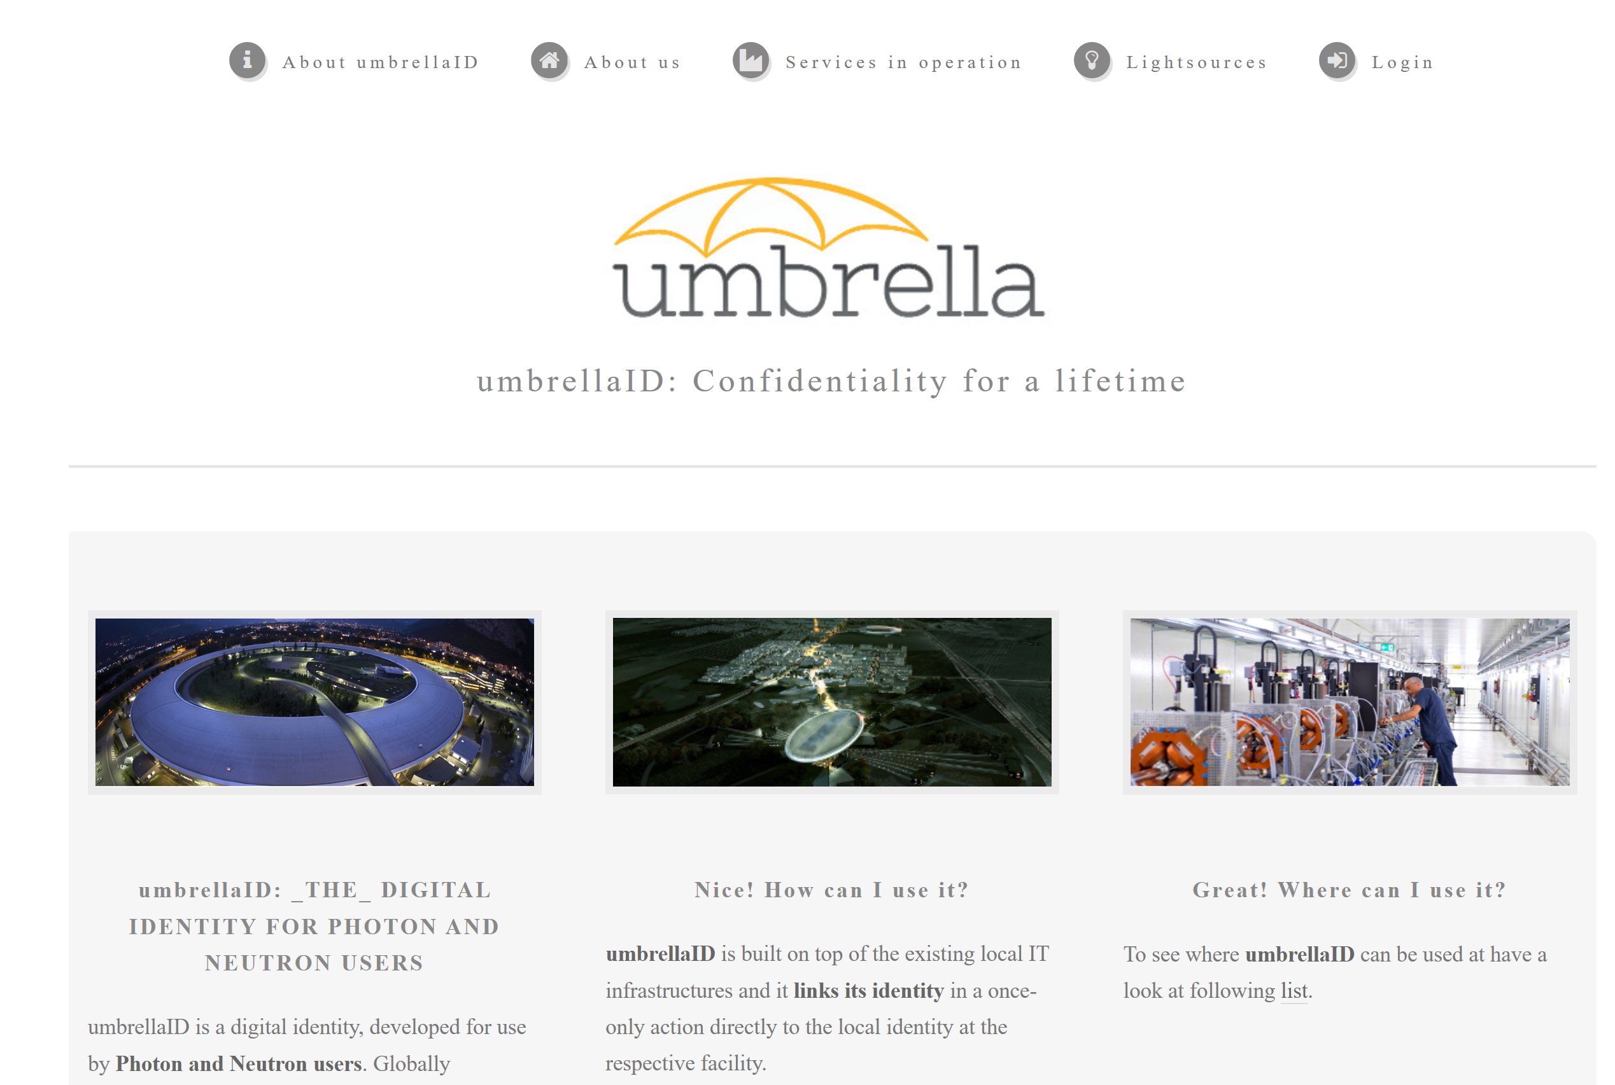
Photon and Neutron AAI - Umbrella
A federated identity system for the users of the (European) large neutron and photon facilities.

Slide 7
Data transfer use cases
From RIs repositories to user services
E.g. EGI Jupyter notebooks / EGI data hub / OneData
From RI repository to an external archive (e.g. STFC archive – 1pb per year)
User driven on-demand transfer (e.g. GLOBUS online, OneData …)
We will need to take into account data embargos
Access data from a common PaNOSC portal for analyzing data
Combine datasets from multiple institutes
Jupyter containers and remote desktops
Working with DESY, STFC, CESNET, EGI, GEANT
Fortnightly telco
Open
https://tinyurl.com/y3fmb5eb

